Slide 1
Do Now
Question 4: Naming Ionic Compounds
Compounds contain a metal and a non-metal (e.g. sodium chloride, NaCℓ). Write the scientific names of the following compounds.
CaCℓ₂ _____________________ Fe₂O₃ _____________________
MgF₂ _____________________ Cu₂S _____________________
Question 5: Naming Compounds
Compounds contain only non-metals and use prefixes to state how many atoms of each element there are (e.g. carbon dioxide, CO₂). Write the scientific names of the following compounds.
NF₃ _____________________ H₂O _____________________
N₂O₃ _____________________ CO _____________________
Calcium chloride
Iron oxide
Magnesium flouride
Copper sulfide
Nitrogen triflouride
Dihydrogen monoxide
dinitrogen trioxide
Carbon monoxide

Slide 2

Daily Review
CFU 1
Have the particles changed? How can you tell?
Physical Changes | Chemical Changes
Same substance remains: particles (atoms / molecules) unaffected Usually reversible Examples: change of shape, change of state | New substance forms: particles are new and different Usually irreversible Examples: gas, light or heat produced; permanent colour change; precipitate formed
CFU 2
Is the change reversible?
CFU 3
Does this change match the description of a physical change or a chemical change?
Does sawing wood cause a physical or chemical change?
Vocabulary
precipitate (noun) an insoluble solid formed from two solutions

Slide 3
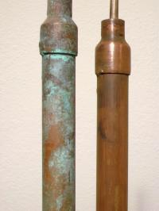
Daily Review
CFU 1
Have the particles changed? How can you tell?
Physical Changes | Chemical Changes
Same substance remains: particles (atoms / molecules) unaffected Usually reversible Examples: change of shape, change of state | New substance forms: particles are new and different Usually irreversible Examples: gas, light or heat produced; permanent colour change; precipitate formed
CFU 2
Is the change reversible?
CFU 3
Does this change match the description of a physical change or a chemical change?
Is copper tarnishing caused by a physical or chemical change?
Vocabulary
precipitate (noun) an insoluble solid formed from two solutions

Slide 4
Chemical Reactions Year 8 Science

Slide 5
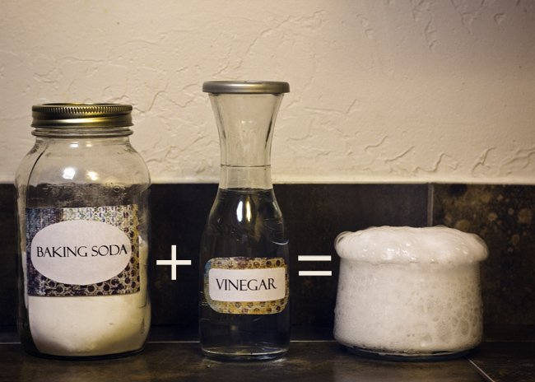
Learning Objectives
CFU
What are the two parts of a chemical reaction we are learning about?
Identify reactants and products in a chemical reaction.
Write chemical reactions as word equations.
Activate Prior Knowledge
Think, pair, share: What happens when you mix vinegar with bicarb soda?
Vocabulary
property (noun) an attribute, quality, or characteristic

Slide 6
Concept Development
CFU 1
What are chemical changes also known as?
Chemical changes are also referred to as chemical reactions.
Products: The new substances that are formed in a chemical reaction.
Reactants: The substances you start with in a chemical reaction.
CFU 2
True or false? The new substances formed in a chemical reaction are called the reactants.
CFU 3
When vinegar reacts with bicarb soda, bubbles of carbon dioxide are formed. What are the reactants and what is the product?

Slide 7
Concept Development
CFU 1
What are products of this reaction?
The products are the substances formed in the reaction.
The starting substances are called the reactants.
When sodium metal is put into water, it reacts violently to form hydrogen gas and sodium chloride.
CFU 2
Name the two reactants in this reaction.

Slide 8
Concept Development
CFU 1
What are products of this reaction?
The products are the substances formed in the reaction.
The starting substances are called the reactants.
When magnesium is burnt, it reacts with oxygen in the air to form magnesium oxide.
CFU 2
Name the two reactants in this reaction.

Slide 9
Concept Development
CFU 1
What are products of this reaction?
The products are the substances formed in the reaction.
The starting substances are called the reactants.
When it is heated, hydrogen peroxide breaks down into water and oxygen.
CFU 2
Name the reactants in this reaction.

Slide 10
Concept Development
CFU 1
How are chemical equations written?
Chemical reactions can be written as chemical equations using words and symbols.
In a chemical equation, the reactants are always written first.
Multiple reactants are separated by a plus (+) sign.
The products are always written second.
Multiple products are separated by a plus (+) sign.
The two sides of the reaction are joined by an arrow (→) pointing towards the products.
CFU 2
Which part of the reaction is written first?
CFU 3
How are multiple reactants separated?
CFU 4
Which way does the arrow point?
Reactants
Sodium + Water
Products
Hydrogen + Sodium hydroxide
→

Slide 11
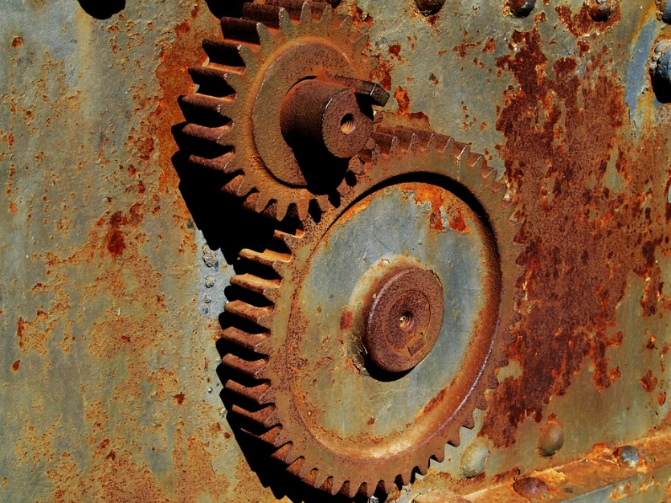
Skill Development / Guided Practice
CFU 1
What are the reactants?
Writing Word Equations
Identify the reactants in the reaction and write them first, with plus signs between each one
Write an arrow at the end of the reactants
Identify the products in the reaction and write them after the arrow, with plus signs between each one
When iron rusts, it reacts with the oxygen in the air to form iron oxide.
CFU 2
What are the products?
Reactants
Iron + Oxygen
Products
Iron oxide
→

Slide 12
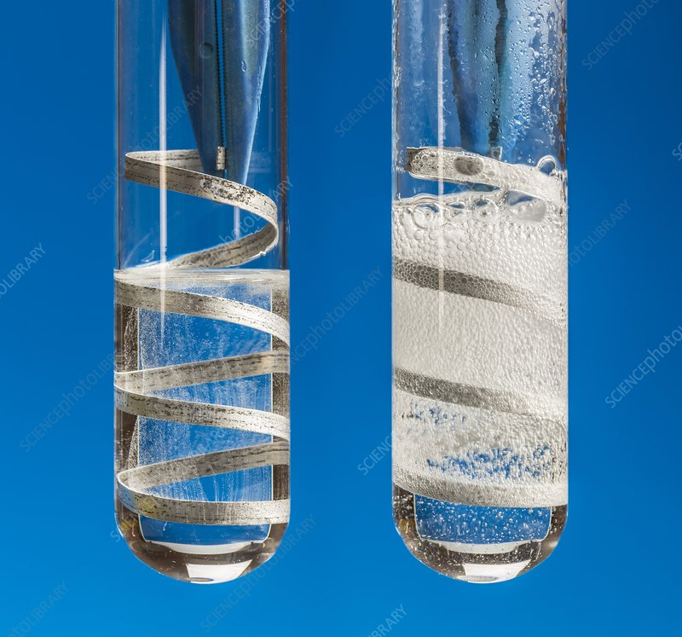
Skill Development / Guided Practice
CFU 1
What are the reactants?
Writing Word Equations
Identify the reactants in the reaction and write them first, with plus signs between each one
Write an arrow at the end of the reactants
Identify the products in the reaction and write them after the arrow, with plus signs between each one
Hydrochloric acid is poured over magnesium metal. It produces magnesium chloride and bubbles of hydrogen.
CFU 2
What are the products?
Reactants
Hydrochloric acid + Magnesium
Products
Magnesium chloride + Hydrogen
→

Slide 13
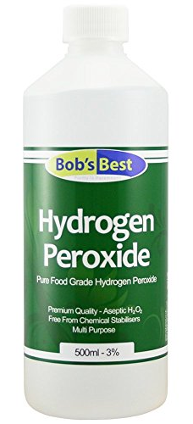
Skill Development / Guided Practice
CFU 1
What are the reactants?
Writing Word Equations
Identify the reactants in the reaction and write them first, with plus signs between each one
Write an arrow at the end of the reactants
Identify the products in the reaction and write them after the arrow, with plus signs between each one
When it is heated, hydrogen peroxide breaks down into water and oxygen.
CFU 2
What are the products?
Hydrogen peroxide
Water + oxygen
→

Slide 14
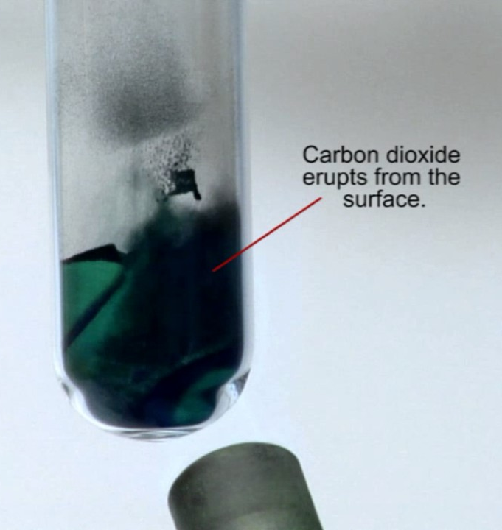
Skill Development / Guided Practice
CFU 1
What are the reactants?
Writing Word Equations
Identify the reactants in the reaction and write them first, with plus signs between each one
Write an arrow at the end of the reactants
Identify the products in the reaction and write them after the arrow, with plus signs between each one
Carbon dioxide and copper oxide are formed when copper carbonate is heated.
CFU 2
What are the products?
Copper carbonate
Carbon dioxide + Copper oxide
→

Slide 15
Relevance
Chemical reactions occur frequently in our daily lives:
When we cook food to eat
When our body breaks down our food through digestion
When our body releases energy from our food by reacting sugar with oxygen
Scientists use chemical equations as a short and concise way to represent chemical reactions.

Slide 16
Skill Closure
Reminder: Writing Word Equations
Identify the reactants in the reaction and write them first, with plus signs between each one Write an arrow at the end of the reactants Identify the products in the reaction and write them after the arrow, with plus signs between each one
Explain the difference between a reactant and a product in a chemical reaction.
Skill Closure
What are the reactants in the reaction below:
Copper oxide is formed when copper metal reacts with oxygen in the air.
Skill Closure
Write an equation to show the following reaction.
To release energy from our food, the human body reacts sugar and oxygen together. This produces two waste products, carbon dioxide and water.

Slide 17
Independent Practice
In your book or on your device, write word equations for each of these reactions:
When fluorine gas comes into contact with calcium metal, calcium fluoride is produced.
After mixing sodium hydroxide with sulfuric acid, sodium sulfate and water are formed.
Iron metal and sodium chloride are produced when sodium metal reacts with iron chloride.
In a car engine, petrol reacts with oxygen and burns. This reaction produces carbon dioxide and water.
Calcium oxide and carbon dioxide are produced when heating calcium carbonate causes it to decompose.
Many buses in WA use hydrogen fuel cells as a source of energy. In this type of fuel cell, hydrogen and oxygen react together to provide energy to the bus. As a result of this reaction, water is produced.

